Slide 1
Symbolic Reasoning

Slide 2
Symbolic AI
Symbolic AI algorithms work by processing symbols, which represent objects or concepts in the world, and their relationships. The main approach in Symbolic AI is to use logic-based programming, where rules and axioms are used to make inferences and deductions.
Let's say we have a Symbolic AI system that is designed to diagnose medical conditions based on symptoms reported by a patient. The system has a set of rules and axioms that it uses to make inferences and deductions about the patient's condition.
For example, if the patient reports having a fever, the system might use the following rule:
IF patient has a fever AND patient has a cough AND patient has difficulty breathing THEN patient may have pneumonia.

Slide 3
Real-World Symbolic AI Applications
Siri and other digital assistants use Symbolic AI to understand natural language and provide responses.
Medical diagnosis systems use Symbolic AI to provide recommendations to doctors based on patient symptoms (as demonstrated earlier).
Autonomous cars use Symbolic AI to make decisions based on the environment, such as recognizing stop signs and traffic lights.

Slide 4
How Symbolic AI differs from other AI Techniques
Symbolic AI differs from other AI techniques, such as machine learning and deep learning, in that it does not require vast amounts of training data. Instead, Symbolic AI is based on knowledge representation and reasoning, making it more suitable for domains where knowledge is well-defined and can be represented in logical rules.
Machine learning, on the other hand, requires large datasets to learn patterns and make predictions.
Deep learning uses neural networks to learn features directly from data, making it suitable for domains with complex and unstructured data.
Symbolic AI is suitable for domains with well-defined and structured knowledge, while machine learning and deep learning are suitable for domains with large amounts of data and

Slide 5
Benefits of Symbolic AI
Interpretability: Symbolic AI provides transparency in the reasoning process, making it easier to understand how a system arrived at a conclusion.
Knowledge representation: Symbolic AI can represent complex knowledge in a formal and structured way, allowing for easy manipulation and reasoning.
Flexibility: Symbolic AI is highly flexible and can be adapted to different domains by modifying the rules and knowledge base.

Slide 6
Limitations of Symbolic AI
Incomplete knowledge: Symbolic AI requires complete and well-defined knowledge to function correctly. In domains where knowledge is incomplete, Symbolic AI may not be effective.
Scalability: Symbolic AI can become computationally expensive as the number of symbols and rules increases, making it difficult to scale to large domains.
Difficulty with handling uncertain or ambiguous information: Symbolic AI relies on precise and unambiguous representations of knowledge, limiting its ability to reason effectively with uncertain or ambiguous data.
Limited ability to learn and adapt: Symbolic AI systems require manual programming and may not allow for real-time learning and adaptation.

Slide 7
Symbolic Reasoning
Monotonic
Non-monotonic

Slide 8
Monotonicity
If a conclusion follows from given premises A, B, C, …
then it also follows from any larger set of premises, as long as the original premises are included."

Slide 9
Non-Monotonic Reasoning
Non-Monotonic reasoning is a generic name to a class or a specific theory of reasoning. Non-monotonic reasoning attempts to formalize reasoning with incomplete information by classical logic systems.

Slide 10
Appproaches
There are two approaches
Non-monotonic logic
Default logic

Slide 11
Non-monotonic logic
It says, "the truth of a proposition may change when new information (axioms) are added and a logic may be build to allows the statement to be retracted.
Non-monotonic logic is predicate logic with one extension called modal operator M which means “consistent with everything we know”. The purpose of M is to allow consistency.
To show that fact P is true, we attempt to prove ¬P.
If we fail we may say that P is consistent since ¬P is false.

Slide 12
Non-monotonic logic…
Example : ∀ x : plays_instrument(x) ∧ M manage(x) → jazz_musician(x) States that for all x, the x plays an instrument and if the fact that x can manage is consistent with all other knowledge then we can conclude that x is a jazz musician.

Slide 13
Default Logic
Default logic provides a framework for expressing and reasoning about incomplete knowledge, making it particularly useful in situations where not all relevant information is known or available. It has been applied in various areas, including artificial intelligence, where dealing with uncertainty and making reasonable assumptions is crucial.

Slide 14
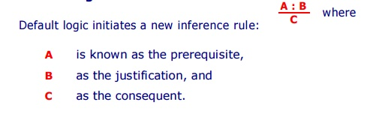
Default Logic…
" if A, and if it is consistent with the rest of what is known to assume that B, then conclude that C ".

Slide 15
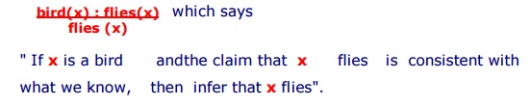
Example : Rule that "birds typically fly" would be represented as
Note : Since, all we know about Tweety is that :
Tweety is a bird, we therefore inferred that Tweety flies.

Slide 16
Default Logic…
The idea behind non-monotonic reasoning is to reason with first order logic, and if an inference can not be obtained then use the set of default rules available within the first order formulation.

Slide 17
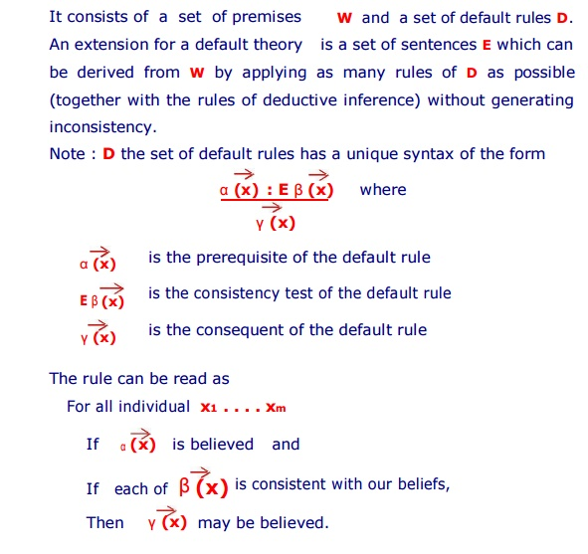
Default Theory

Slide 18

Example
A Default Rule says " Typically an American adult owns a car ".
The rule is explained below :
The rule is only accessed if we wish to know whether or not John owns a car then an answer can not be deduced from our current beliefs.
This default rule is applicable if we can prove from our beliefs that John is an American and an adult, and believing that there is some car that is
owned by John does not lead to an inconsistency.
If these two sets of premises are satisfied, then the rule states that we can conclude that John owns a car.

